Slide 1
The beauty of descriptive models – and bodyfat (the beast)
Georg Heinze Medical University of Vienna, Institute of Clinical Biometrics
Mariana Nold University of Jena, Department of Socioloy

Slide 2
Outline
On descriptive modeling
The (ir)relevance of variable selection
New task: predicting the percentage of body fat with a 5-parameter linear model

Slide 3

Purpose of models: To Explain or to Predict?
Predictive models
Interest in predicting outcome for future application.
“Predict how outcomes will be, given the predictors.”
Explanatory models
Interest in inferring causal effects of interventions on outcome.
“Explain why outcomes differ depending on the intervention.”
Descriptive models
Interest in describing the data structure parsimoniously.
“Describe how outcome varies with predictors.“
A given modeling task may have several dimensions! (e.g. descriptive-predictive)
Similar considerations by Hernan et al, 2019; and Carlin and Moreno-Betancur, 2025
(Shmueli, 2010)
Notes:
Hier in der Reinform – gibt es nicht wirklich in Praxis.
WRONG: High explanatory power ➔ high predictive power.
prognostic models: predict future outcomes of diseases and/or treatments.
predictive models: identification of patients at high risk for certain.
Types and purposes of statistical models I
Explanatory modeling/models:
Theory itself provides the justification for the causality. Therefore, in social sciences often use of observational data for this purpose (association-based statistical models).
Strong theory, reliance on data and statistical modeling through the lens of the theoretical model.
Focus on theoretical constructs than on measurable variables. Use of causal diagrams illustrating relationship between these constructs.
Statistical inference: effects sizes and statistical significance in relation to the causal hypotheses.
Causality is of main concern.
Test hypotheses about effect sizes.
Explanatory models refer to the application of statistical models to data for testing causal hypotheses about theoretical constructs.
Goal: in-sample explanatory power
Predictive modeling/models:
Goal is to predict new/future observations; for a new observation predict the output Y given their input variable X.
This includes point and interval prediction, prediction regions, predictive distributions or rankings of new observations.
No direct interpretability is (strictly speaking) required (but often desirable). ➔ association
(Can be used as a ‚reality check‘ to the relevance of theories, as a predictive model either predicts accurately or not. Explanatory models can never be confirmed and are harder to contradict.)
Goal: Out-of-sample predictive accuracy
Descriptive modeling/models:
Goal is to summarize the data structure parsimoniously.
No or weak reliance of theory with a focus on the measurable level rather than at the construct level. No focus on prediction.
Goal: covariates with strong influence on the outcome, functional form
Etiological models in medicine ? (only some theory)
Important: Models with high explanatory power do not have automatically high predictive power. ➔ Therefore, statistical modeling (from study design on) should be influenced on the type of statistical model required.
Why is there a difference between explaining and predicting?
Different type of uncertainty.
Because measureable data are not accurate representations of their underlying constructs.
Theory: construct X causes construct Y via the function F, Y=F(X). Measureable variables are X and Y (=operationalisations of X and Y). ➔ Statistical modeling: E(Y)=f(X), where f is the statistical model. Usually not a single f. Explanatory models: match f and F as closely as possible for the statistical inference to apply to the theoretical hypotheses. Predictive models: X and Y are of interest. Function f is used as a tool for generating good predictions of new Y values.
Even is the underlying causal relationship is indeed Y=F(X), a function other than f_hat(X) and data other than X might by preferable for prediction. ➔ The wrong model can sometimes predict better than the correct one.
Bias-variance: expected prediction error for a new observation using a quadratic loss function (Hastie, Tibshirani, Friedman, 2009, p. 223): EPE = Var(Y) + Bias^2 + Var(f_hat(x)) Explanatory model: minimize bias to obtain the most accurate representation of the underlying theory. Predictive model: minimize bias and estimation variance
Konishi and Kitagawa (2007): no significant difference between explanatory and predictive models if infinite large sample without noise is available.
Bias – Variance
Expected prediction error for a new observation with value x, using a quadratic loss function (Hastie, Tibshirani, Friedman, 2009, p. 223).
Var(Y) = error even if the model is correctly specified and accurately estimated.
Bias = misspecification of the statistical model f.
Var(f\hat(x)) = results from using a sample to estimate f. (estimation variance)
Explanatory models: focus on minimizing the Bias^2 to obtain the most accurate representation of the underlying theory. Predictive models: minimize Bias^2 and estimation variance. Okay to sacrifice theoretical accuracy for improved precision.
Infinite sample and no measurement errors= explanatory model and predictive model the same (? Schlußfolgerung Daniela)
-------------------------------------------------------
LITERATURE:
Shumeli 2010
Tripepi 2008
Harrell 2001 book, chapter 1
-------------------------------------------------------

Slide 4
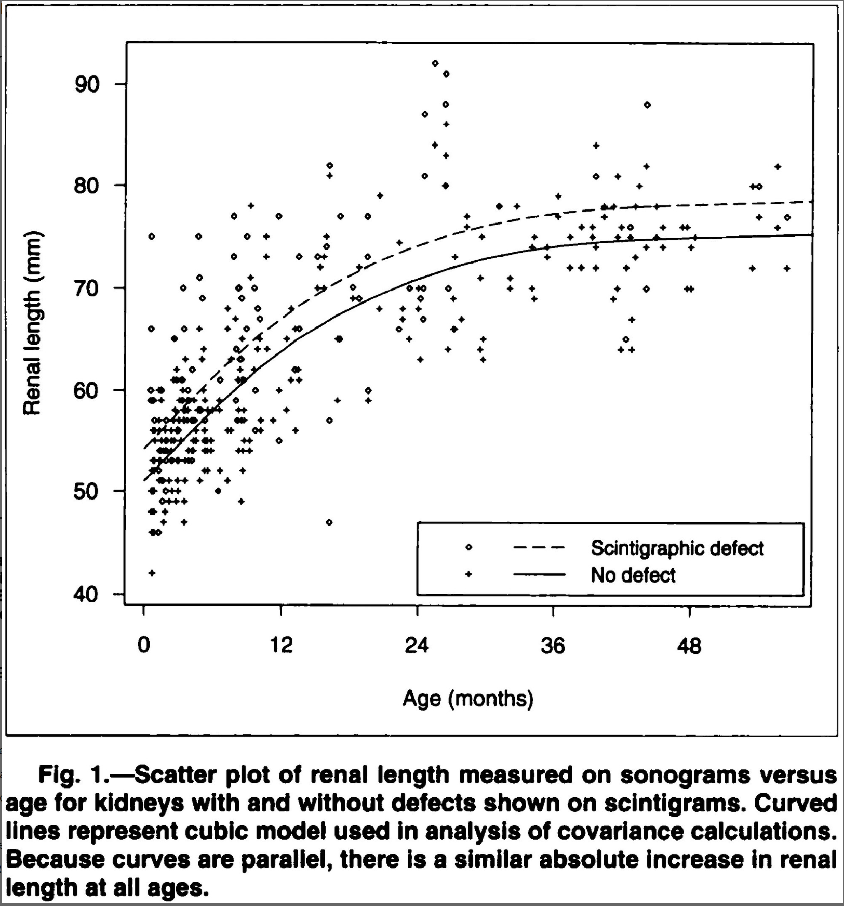
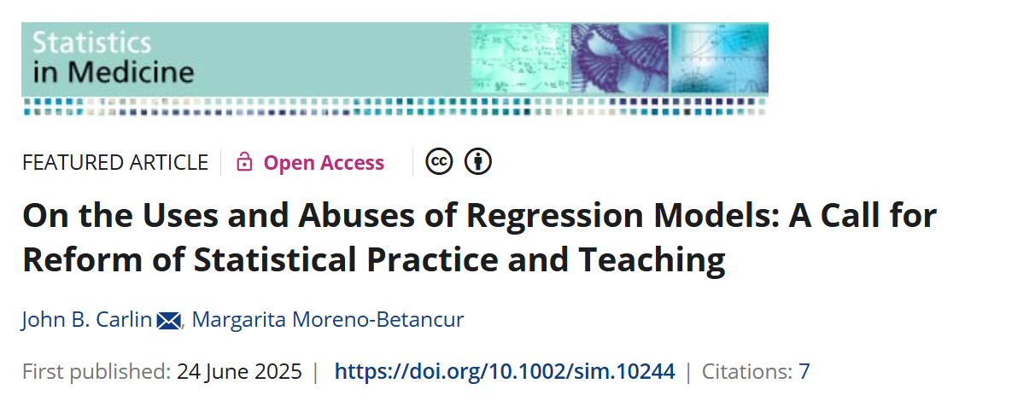
No other modeling task than the ‚trichonomy‘ (D/P/E)
Descriptive purpose of modeling: „characterizing the distribution of a feature or health outcome in a population”
Here: “curve fitting”
Model makes an important assumption. Which one?

Slide 5
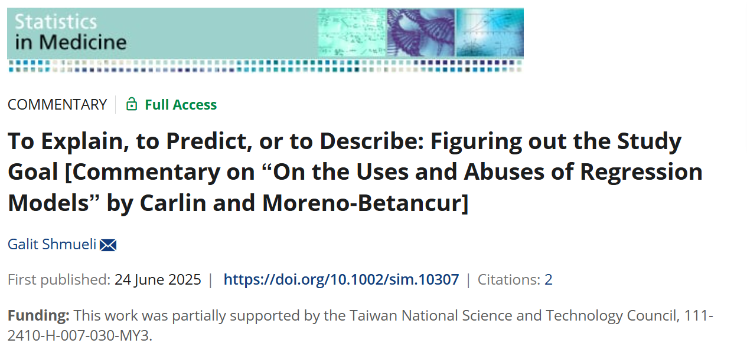
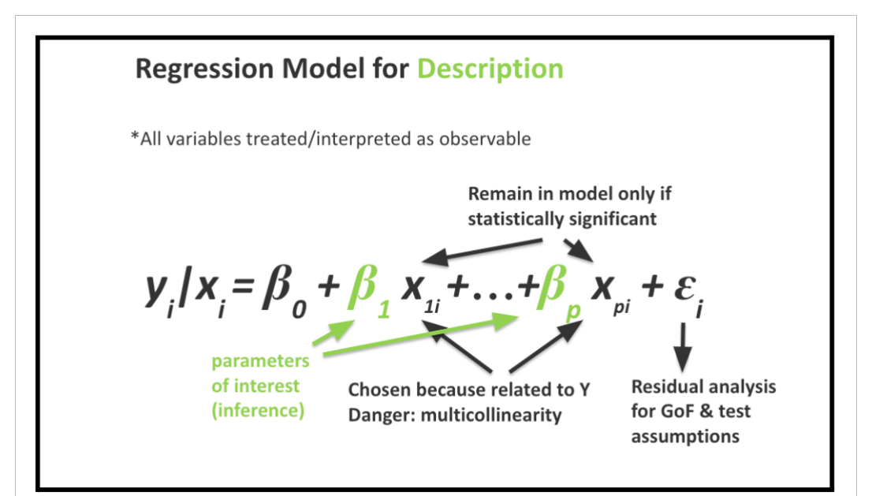
Unit of action: individual or collective?
Description of means in (sub)populations (collective), description of expected values with given covariates (individual, see Mariana‘s task), or description of differences between means (=associations, collective)?
Variable names matter:
Predictors, confounder/collider/mediator/instrument, covariate/independent variable?

Slide 6
Here are two typical tasks of descriptive modeling
To describe the association of an „outcome“ Y with the essential covariates X using a model, selected from a larger set of possible models
Parsimonious description using a simple statistical model
Variable selection, simple functional forms
Easy to derive partial associations from the model
Easy to make statements about expected values of Y|X
Risk of overestimation/overinterpretation of partial associations, neglecting others
Risk of underestimation of uncertainty
To describe a non-causal association of an outcome Y with an independent variable/exposure X, possibly adjusted for covariates
‚Curve fitting‘:
smoothing as variance-bias trade-off
separate systematic from unsystematic variation
simple equations preferred for description (try to publish a formula with truncated power functions in a medical journal!)
Example: Kidney length difference by age, CV risk by Lipoprotein(a), BMI by age+sex

Slide 7
A new task: predicting body fat
Background:
Body fat measurement difficult; needs underwater density measurements to estimate lean body mass; fat mass = total mass – lean mass bodyfat% = fat mass / total mass x 100%
Various models to predict body fat have been published, e.g. based on NHANES data (Stevens et al, 2016)
Two data sets were published by Johnson (1996, 2021)
Research question: The percentage of bodyfat should be predicted using 5 out of a larger set of anthropometric variables. The model should be ‚describable‘ but also predictive: descriptive-predictive modeling task.
Data set:
Training: Data set provided by Johnson (2021): 184 college women aged 18-25
Validation: Data set provided by Johnson (1996): 252 men aged 18-80

Slide 8
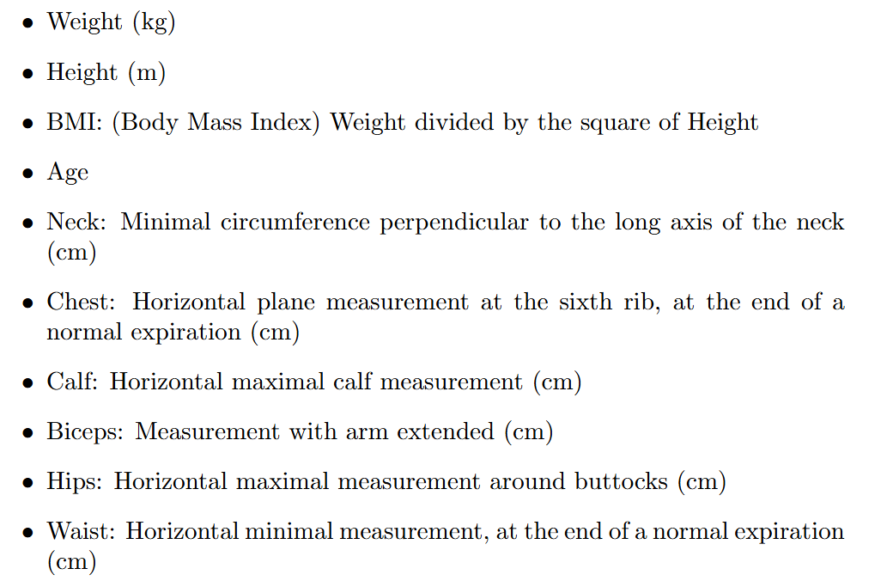
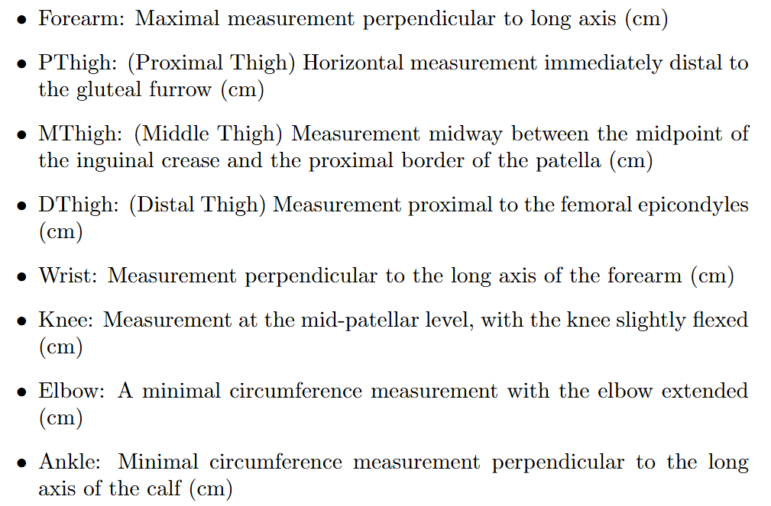
Predictor to choose from

Slide 9
Estimands
Selection of predictors (binary)
Regression coefficients of predictors and their uncertainty
External validation: performance and transportability of the model
R-squared
Root mean squared prediction error
Calibration slope + intercept
descriptive
predictive

Slide 10
Proposed model and modeling approach
Linear regression model with linear functional forms only
One could argue that %bodyfat is restricted between 0-100% -> zero-inflated beta model?
Variable selection to obtain max. 5 predictors
Simple and describable model
Relaxed Lasso with fixed model size (5)
Assessing apparent validity
Overall (local) calibration: residuals vs. linear predictor
Validity of linearity assumption: residuals vs. included predictors
Independence of residuals: residuals vs. excluded predictors
Distributional assumption: normality of residuals

Slide 11
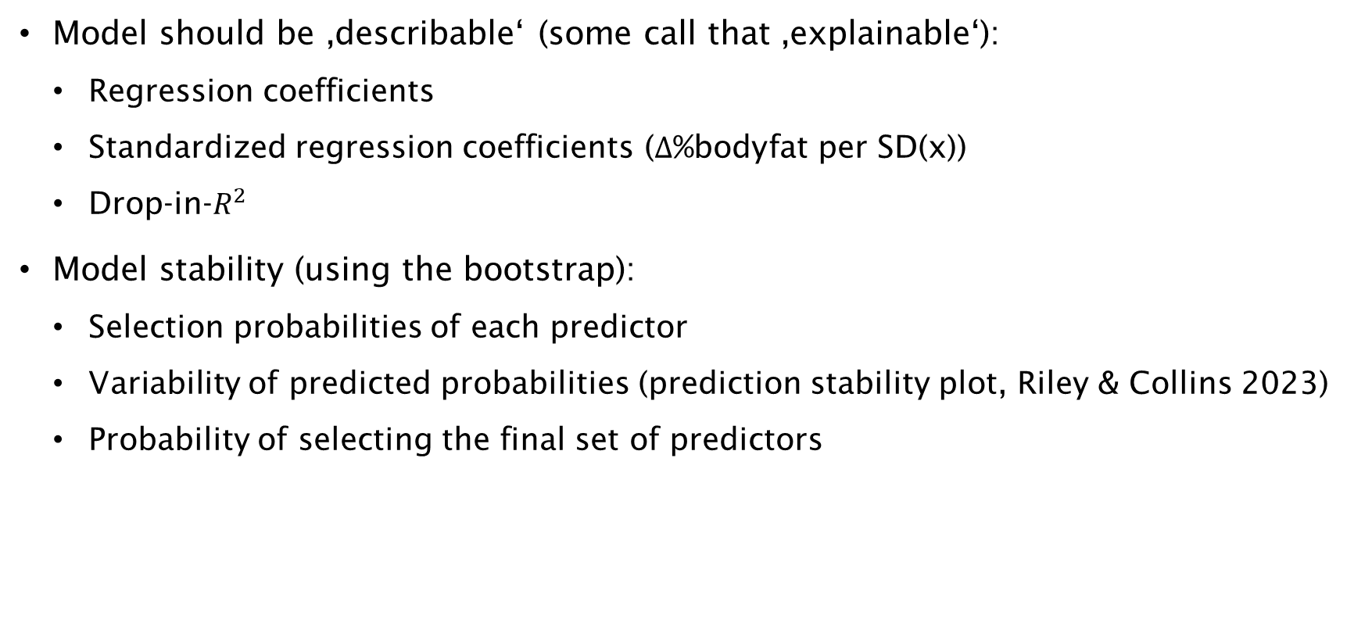
Model description
Model should be ‚describable‘ (some call that ‚explainable‘):
Regression coefficients
Standardized regression coefficients ($Δ$%bodyfat per SD(x))
Drop-in-$R^{2}$
Model stability (using the bootstrap):
Selection probabilities of each predictor
Variability of predicted probabilities (prediction stability plot, Riley & Collins 2023)
Probability of selecting the final set of predictors

Slide 12
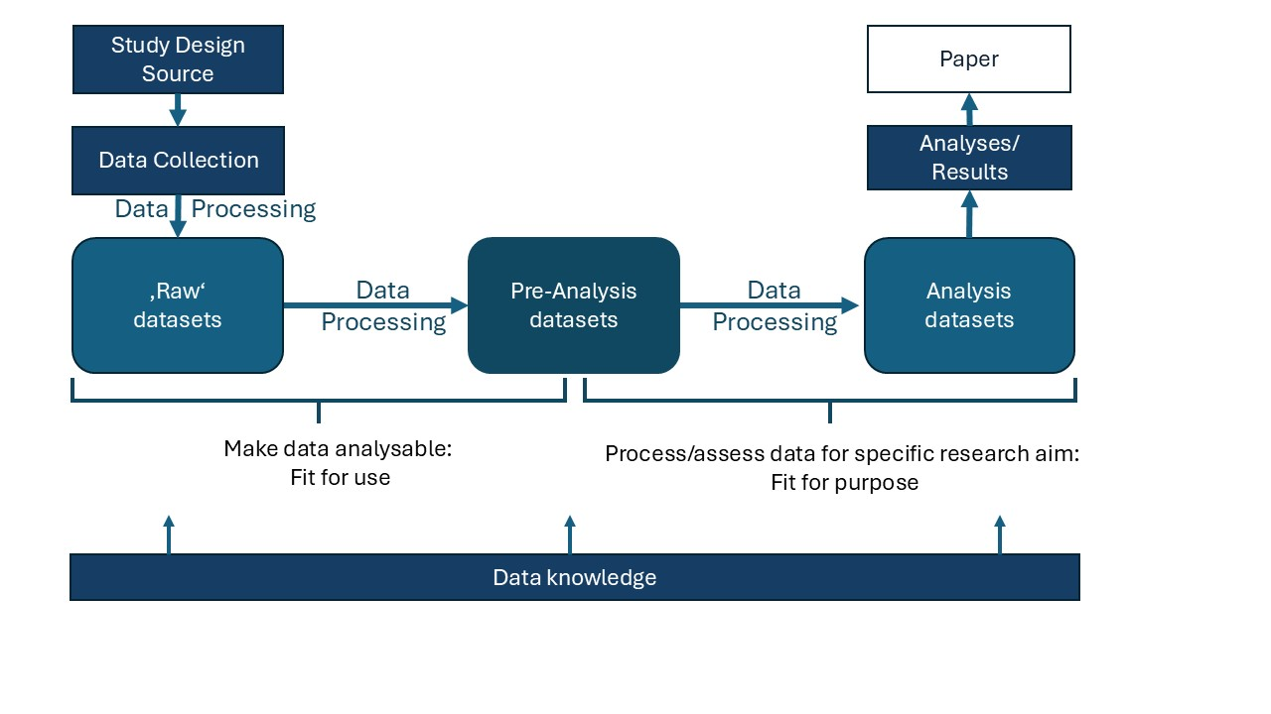
Data preparation
From Schmidt, Klinger, Sauerbrei, Heinze (2025), Biometric Bulletin 42(2) (current issue):
The two data sets have in-built data errors, which need to be corrected
Some variables have different names, some have somewhat different definitions

Slide 13
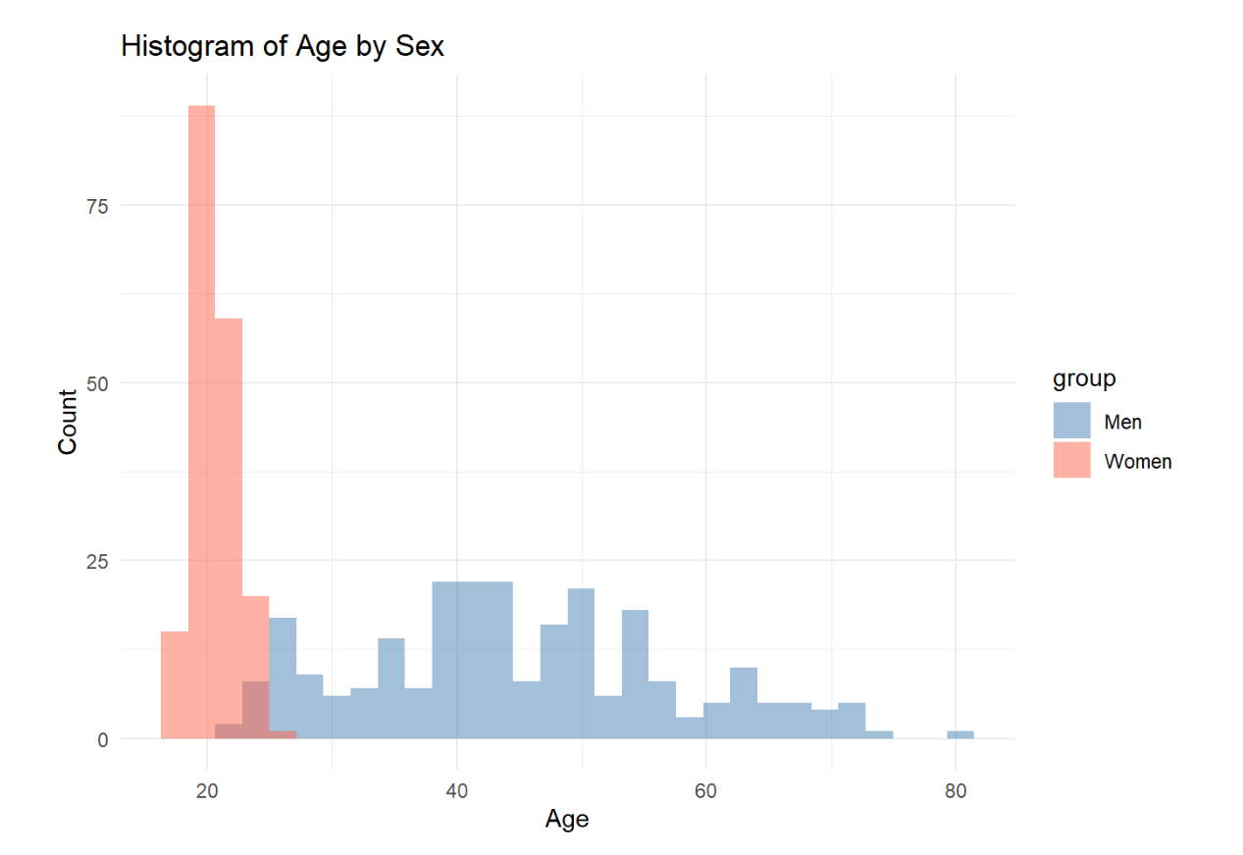
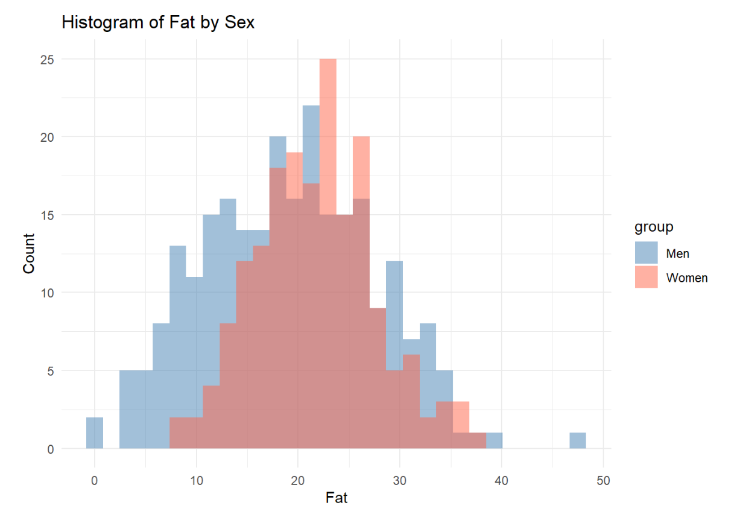
Data preparation
Data errors were corrected (set to NA)
Data sets were harmonized
IDA was performed

Slide 14
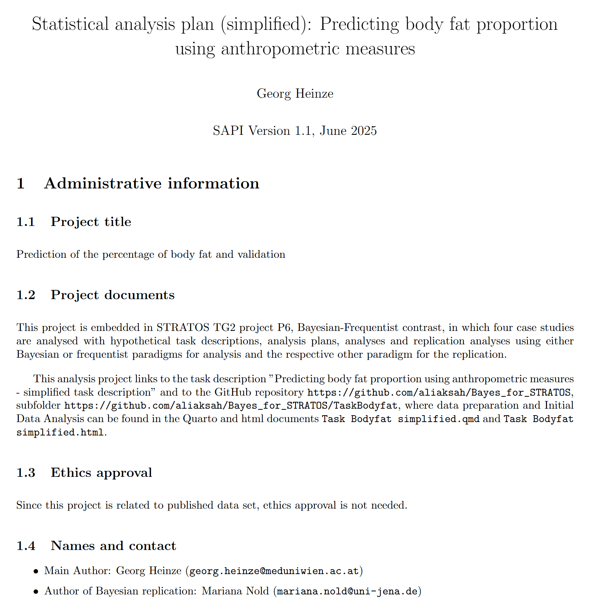
Statistical Analysis Plan
We created a SAP according to SAPI guideline (currently under development, see https://osf.io/zfjah/
The SAP integrates main analysis and Bayesian robustness check
Analyses performed in our shared GitHub repository

Slide 15
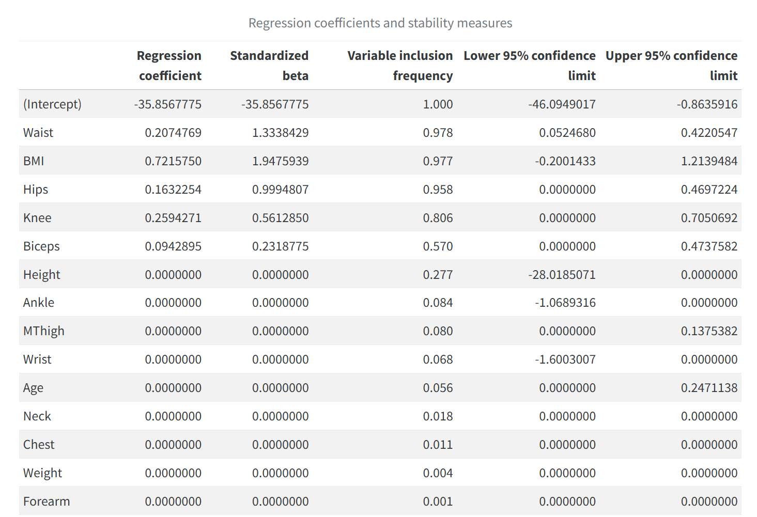
Results
Via the bootstrap

Slide 16
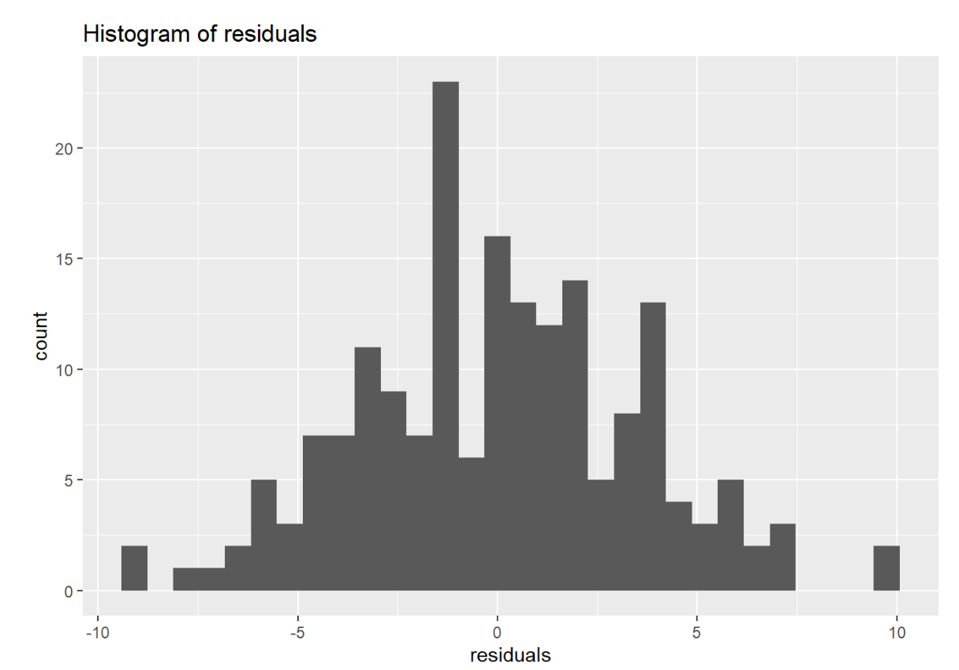
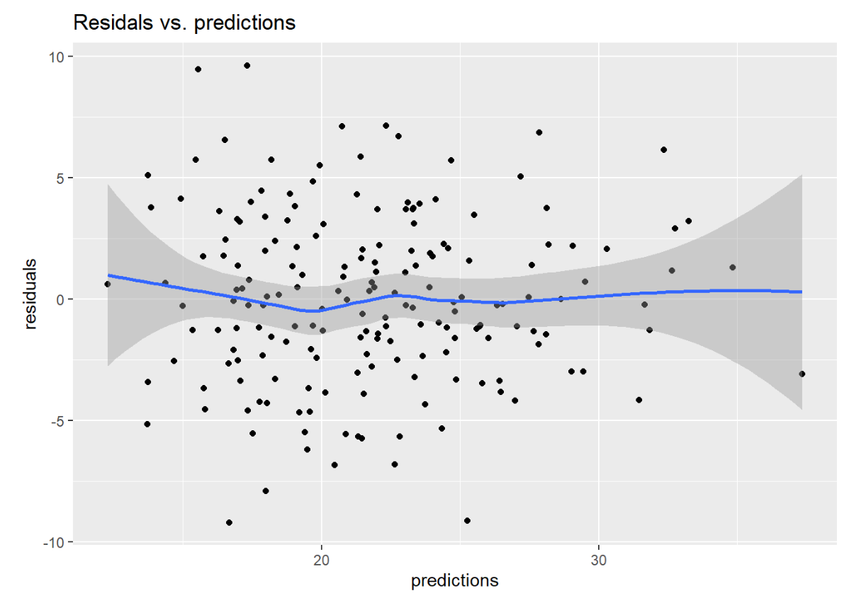
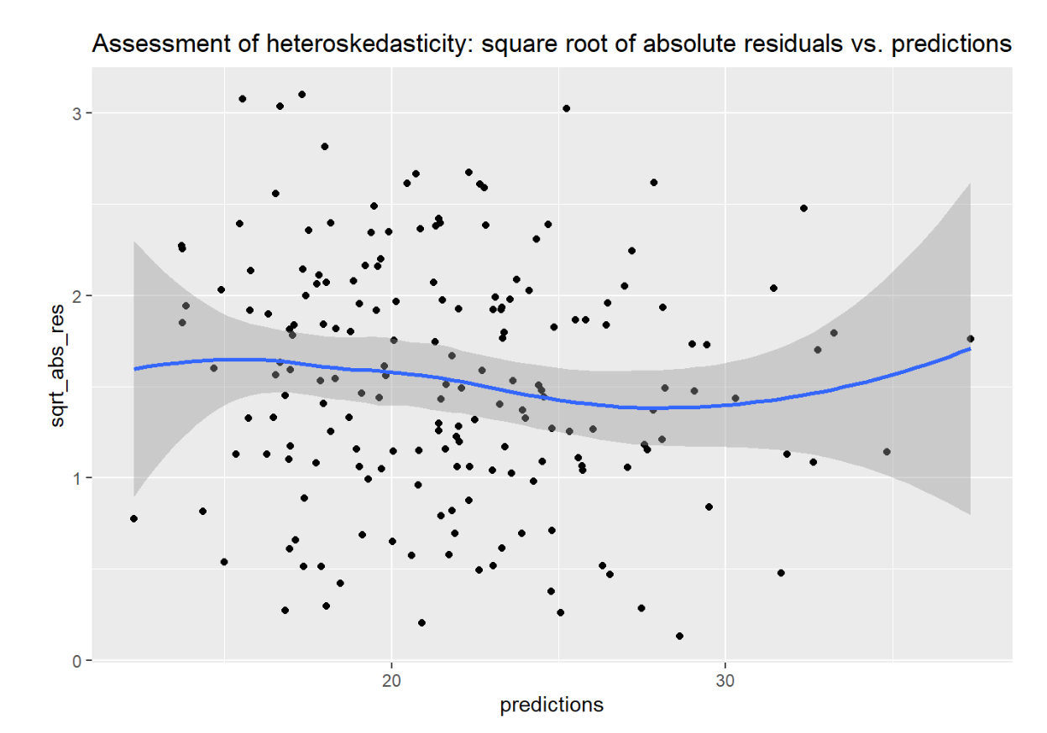
Model diagnostics

Slide 17
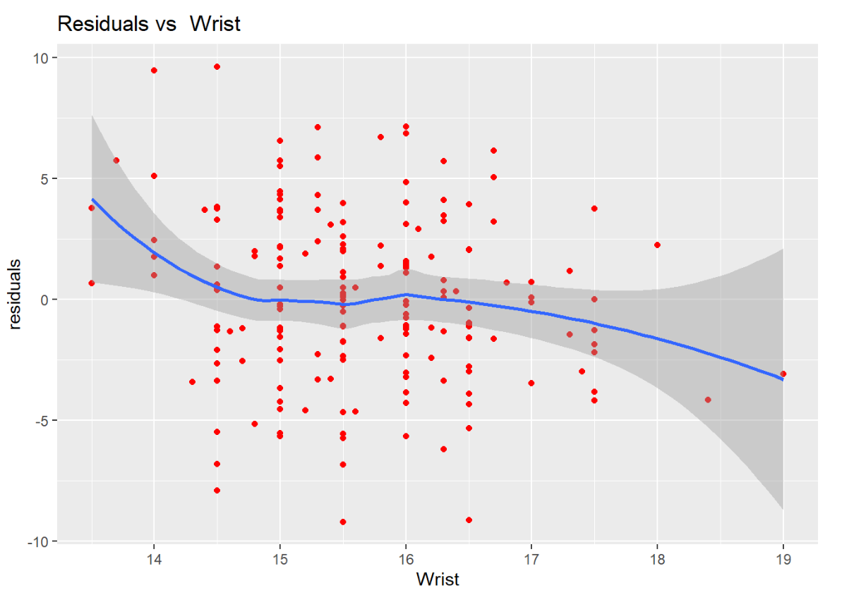
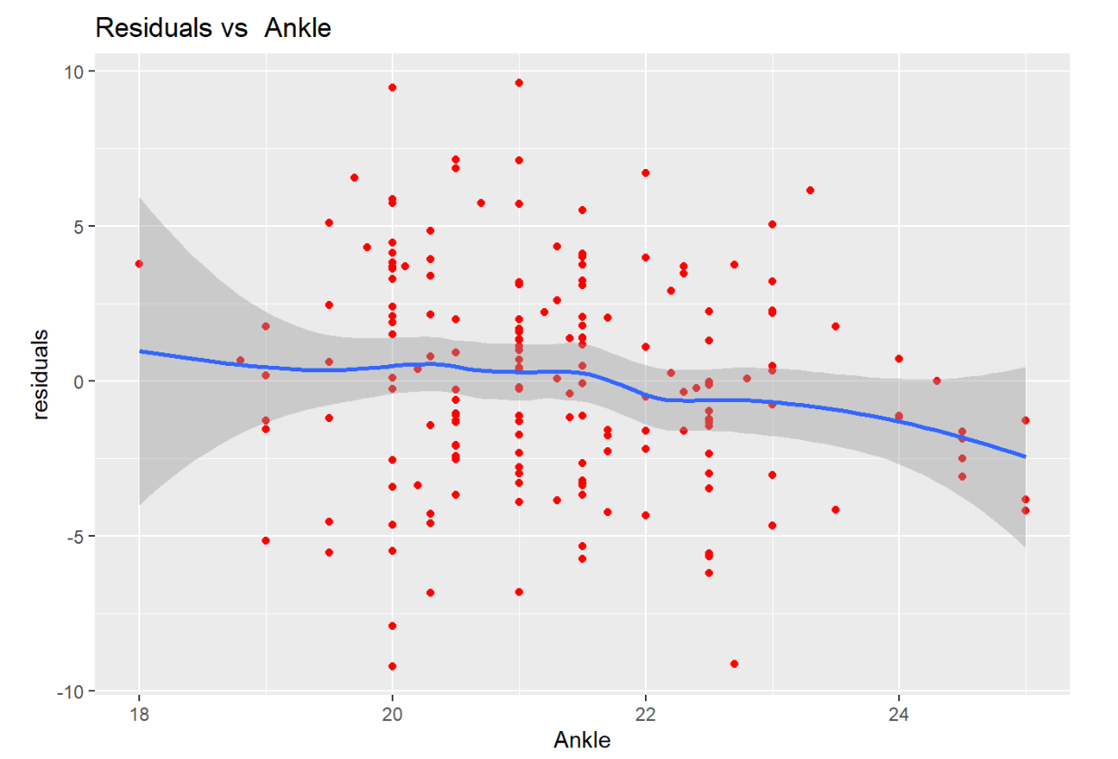
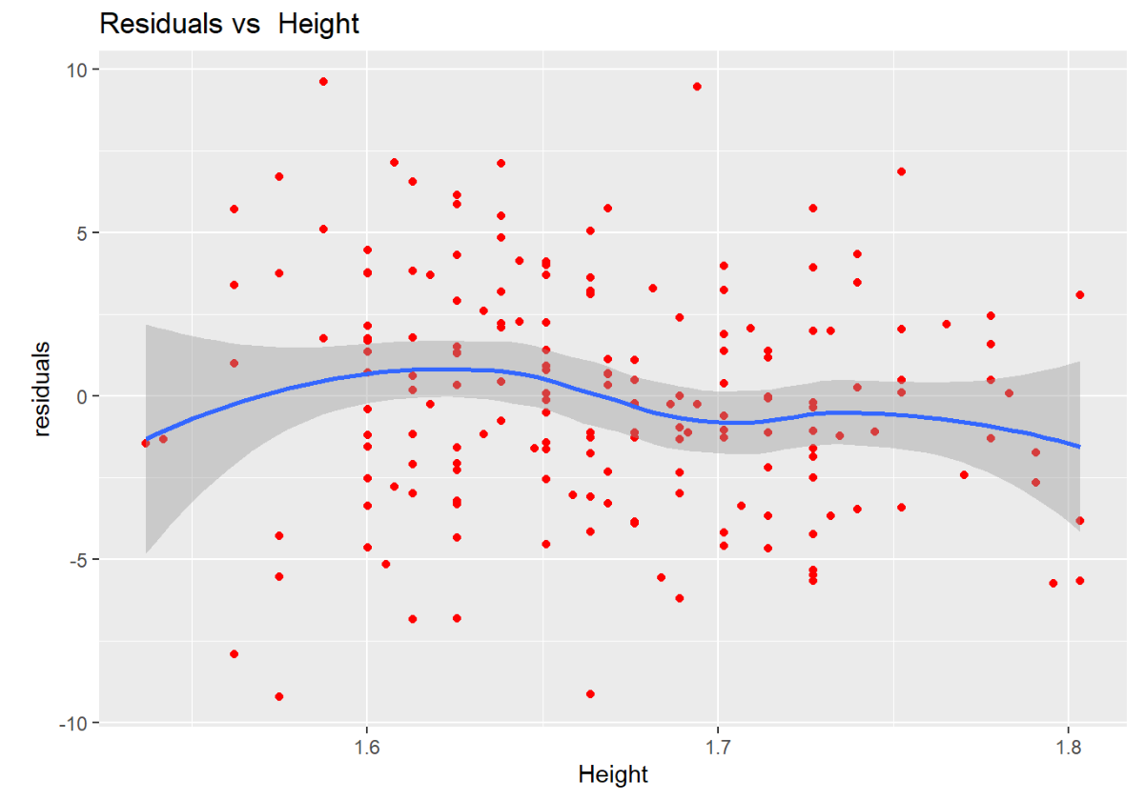
Residuals vs. excluded predictors
The residuals vs included predictors plots did not indicate major problems.
We also assessed residuals vs the top-3 excluded predictors (if Lasso path is extended to 8 variables):
These variables are most likely to show issues, as they were ‚next on the list to be included‘

Slide 18
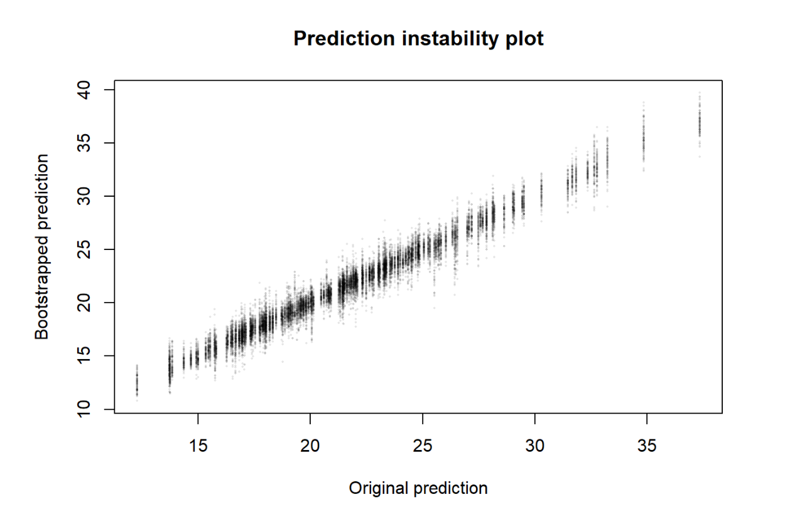
Prediction instability plot
Bootstrap RMSE of fitted values: 0.823
Model-based RMSE of fitted values: 0.640
→ Variable selection produced ‚unnoticed uncertainty‘!

Slide 19
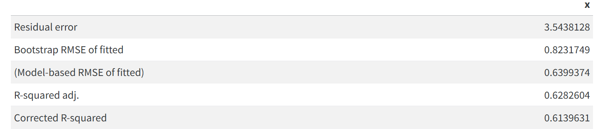
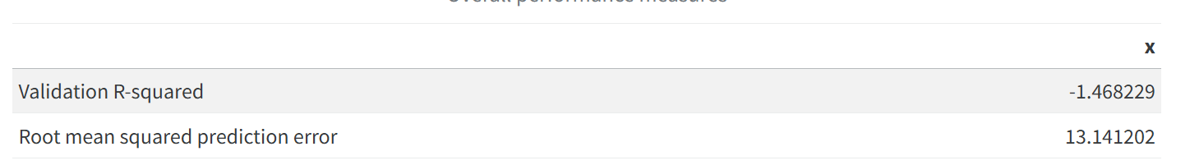
Model validation
Apparent:
At validation in men:

Slide 20
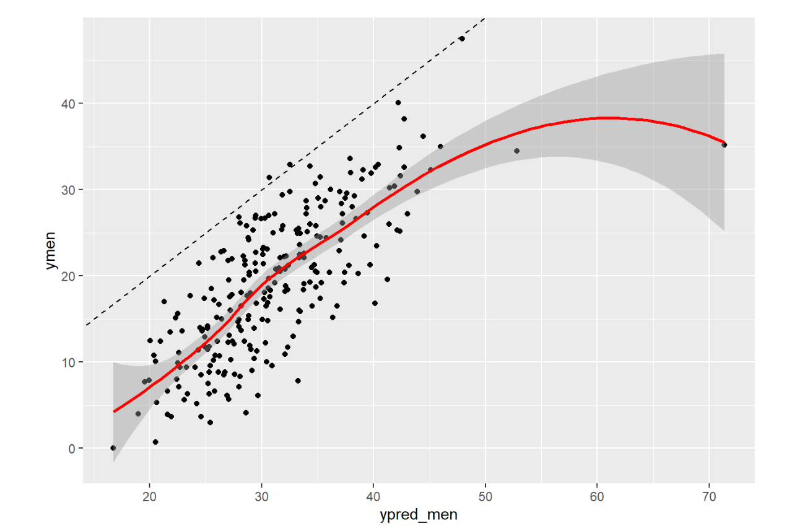
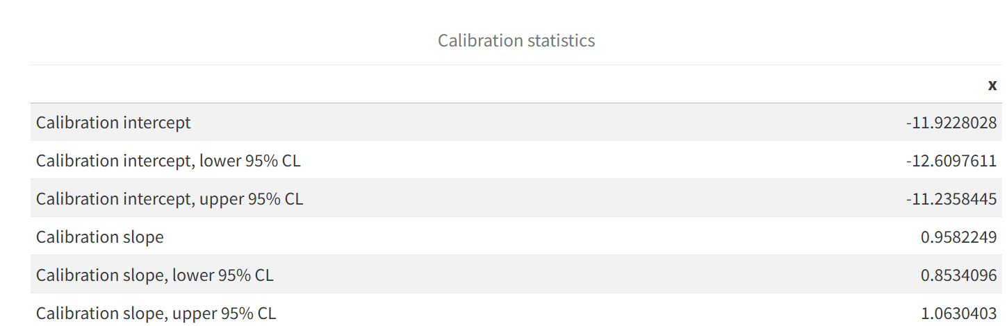
What went wrong? Calibration plot to the rescue!
Calibration analysis revealed that bodyfat% is overpredicted 11.9%-points
But Calibration slope is almost ideal
→The same formula can be used for women and men, but intercept has to be recalibrated

Slide 21
Two-Stage Strategy in Prediction and feature selection (R-package projpred)
Many traditional approaches attempt to solve prediction and feature selection simultaneously. R-package projpred proposes a decision theoretic two-stage approach:
Stage 1: Researcher builds a Reference Model
- Fit the best possible predictive model using all relevant features -> validate this model
- This model serves as the reference for later comparisons
Stage 2: Algorithm finds a Minimal Subset of Features that Characterize the Predictions (Predictive Projection)
- Select the model with the smallest predictive discrepancy to the reference (final model)
- For each level of complexity (number of features), finds the best-performing subset

Slide 22
Predictive Projection – Motivation for Robustness Analysis: Why this approach?
First, it targets the statistical focus of this case study: balancing predictive power and model simplicity via feature selection. Second, projpred offers LOO-L1 strategy using elastic net with relaxation- closely aligned with relaxed Lasso and the original analysis. See: Piironen et al. (2020), Projective Inference in High-Dimensional Problems.
Key Advantages:
Clean separation of selection and validation: Selection on training data only; evaluation on validation data only → Prevents selection-induced bias (automatically handled by cv_varsel(), based on relative cross-validated pointwise utilities computed exclusively on validation data) → aggregated over folds, thus one mean utility for a given complexity (number of features)
Post-selection inference: Accounts directly for variable selection uncertainty via the reference model → the projected posterior for the final submodel retains uncertainty from the reference model’s posterior.

Slide 23
Robustness Analysis – Comparison with Original Study
Consistency with Original Study:
Same key variables selected: BMI, Waist, Hips, Knee, Biceps
Final regression model shows similar coefficient estimates and uncertainty intervals
Bayesian Enhancements:
Enables uncertainty intervals for out-of-sample R² via posterior predictive distribution
Also allows uncertainty quantification for calibration intercept and slope
Validation Perspective:
Concepts like optimism correction and resampling align more with frequentist thinking (sampling distributions)
Traditional Bayesian view treats data as fixed and focuses on utilities to select variables. Modern Bayesian prediction culture embraces internal validation → Can be combined with methods like bootstrap to assess generalization
Notes:
My robustness analysis yields results consistent with the original study e. g. same variables selected: "BMI" "Waist" "Hips" "Knee" "Biceps“, final regression model has similar regression coefficients estimates and uncertainty intervals
Some differences e. g. In Bayesian inference, I can report an uncertainty interval for the out-of-sample R², based on the posterior predictive distribution or uncertainty intervals for calibration intercepts and calibrations slope based on corresponding posterior distributions.
Concepts like optimism correction and resampling-based validation fit more naturally into the frequentist framework of sampling distributions than into traditional Bayesian thinking, which treats the data as fixed and focuses on posterior summaries.However, the modern Bayesian prediction culture increasingly embraces internal validation as a meaningful tool for assessing generalization and can be combined with e. g. bootstrap.

Slide 24
Summary of example
Agreement in selected variables
Calibration intercept and slope at external validation similar → similar overall conclusion
Variable selection has been said to generate uncertainty that often goes unnoticed (see also Heinze et al, 2018)
Compared to their results, we see less variation if the number of predictors is fixed in advance
E.g., four predictors with VIF>80%, 1 with 50%, next one with <25%
Still, additional uncertainty in predictions (compared to assuming the selected model was fixed in advance)
Bootstrap may overestimate this variability (see also Wallisch et al, 2021)
Concept of ‚selection probability‘ not well defined in frequentist statistics
Pragmatic way of quantifying uncertainty
Multi-model inference not easy to explain from frequentist viewpoint: Bayesian ‚reference model‘ for inference – frequentist ‚global model‘ (see also Heinze et al, 2018)

